Slide 1
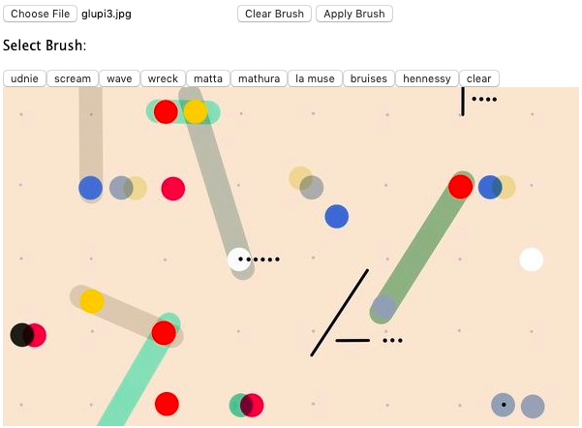
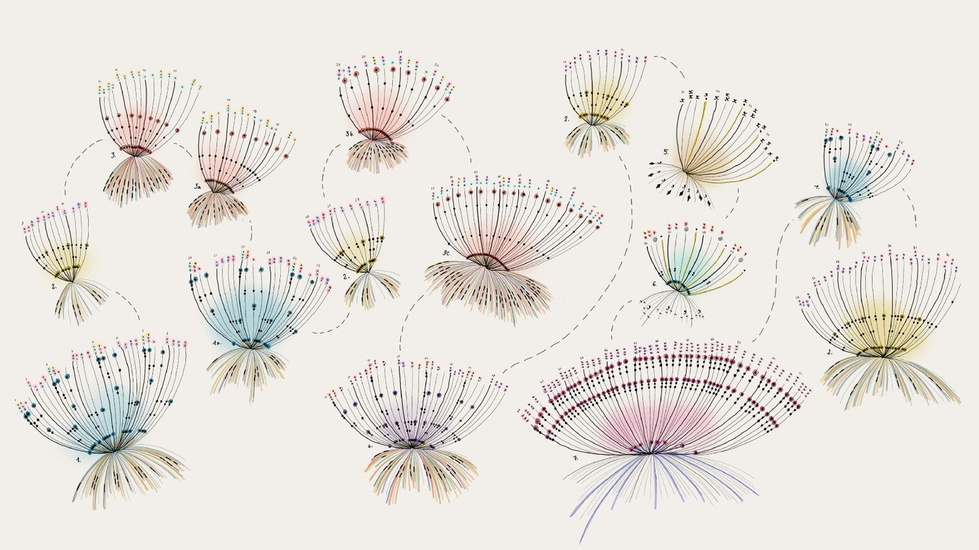
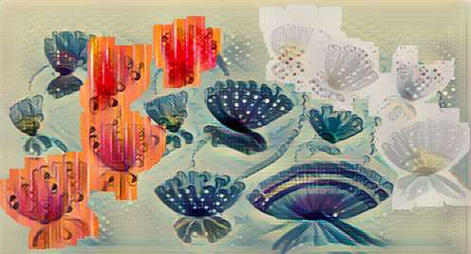

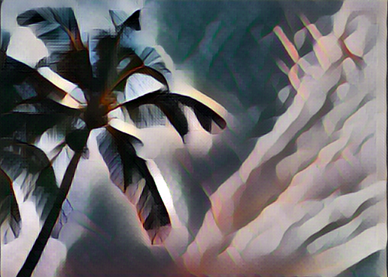
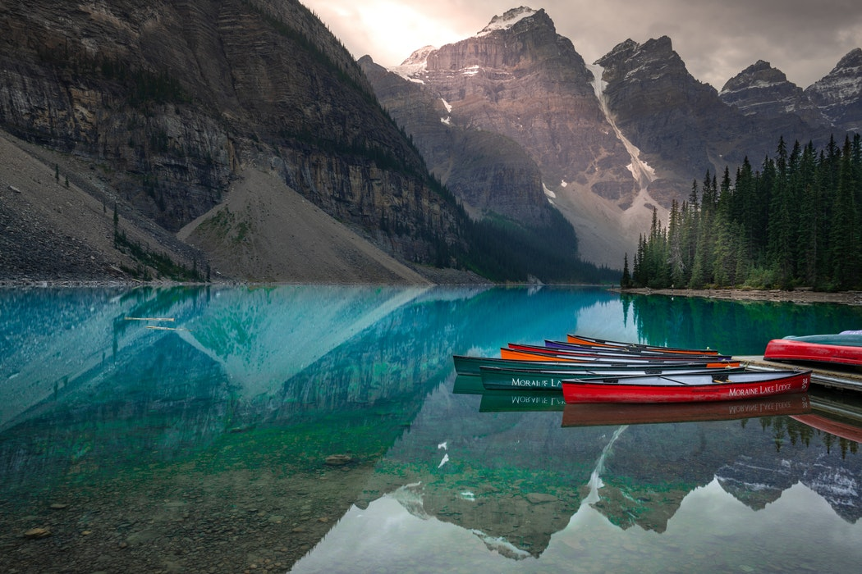
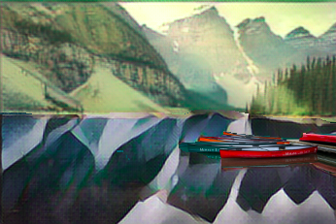
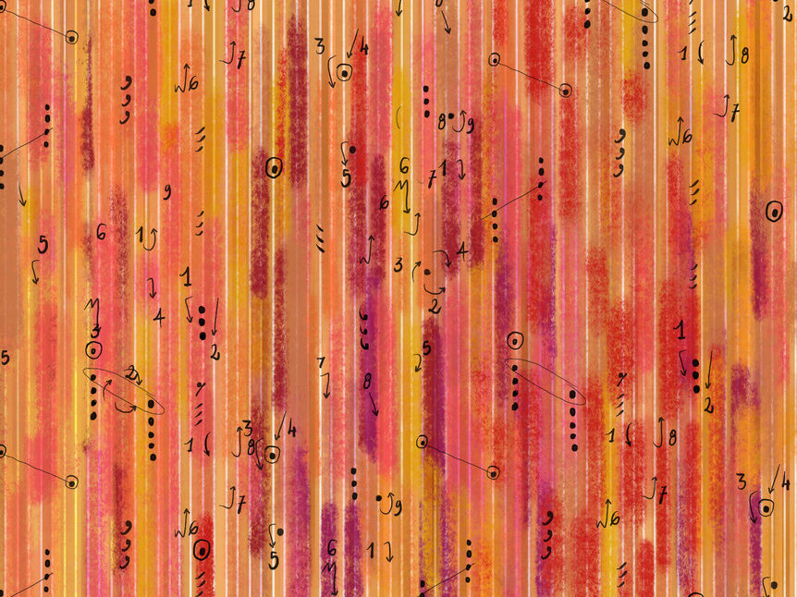
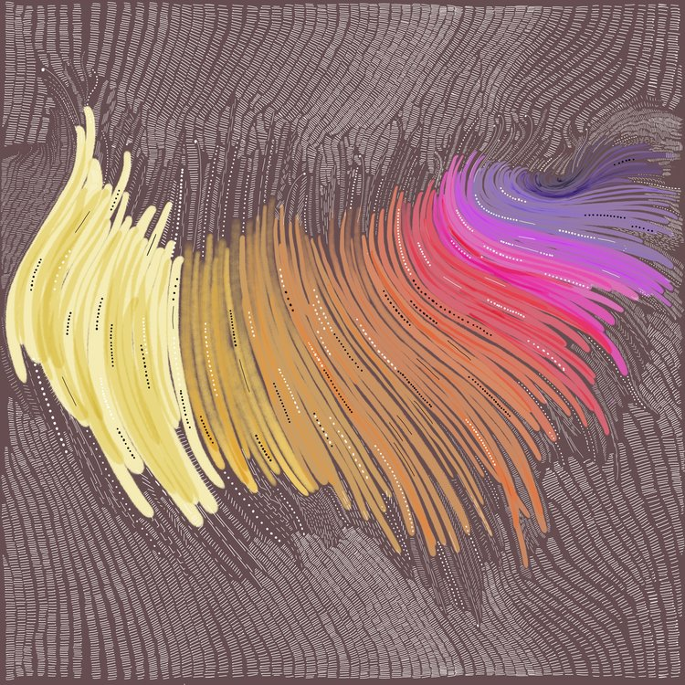
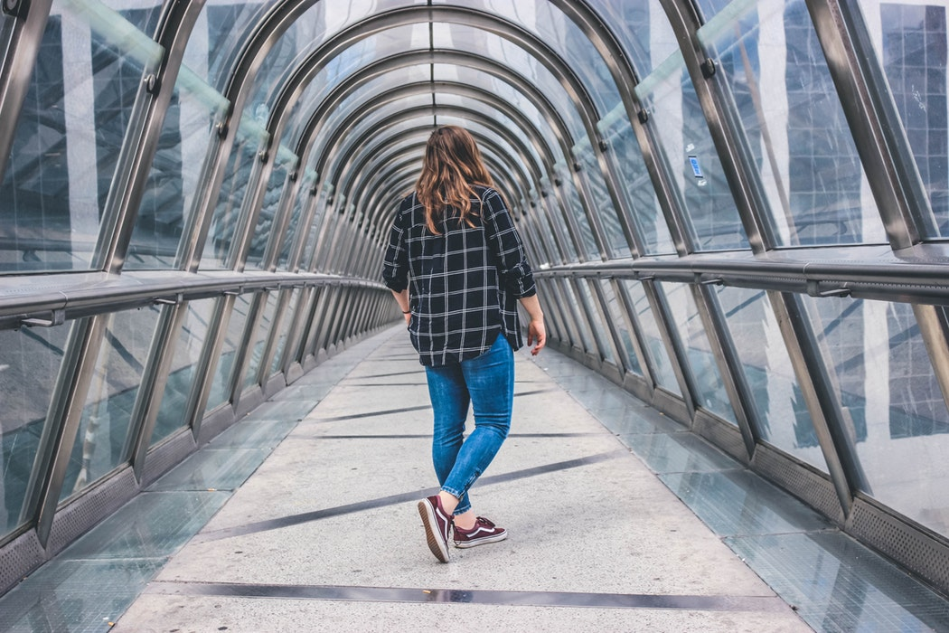
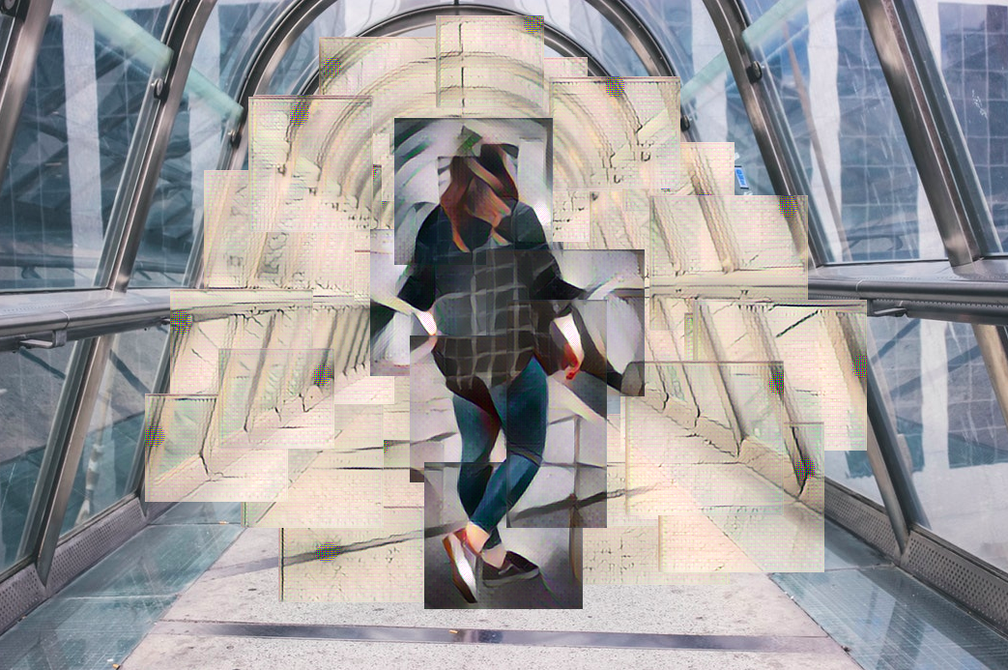
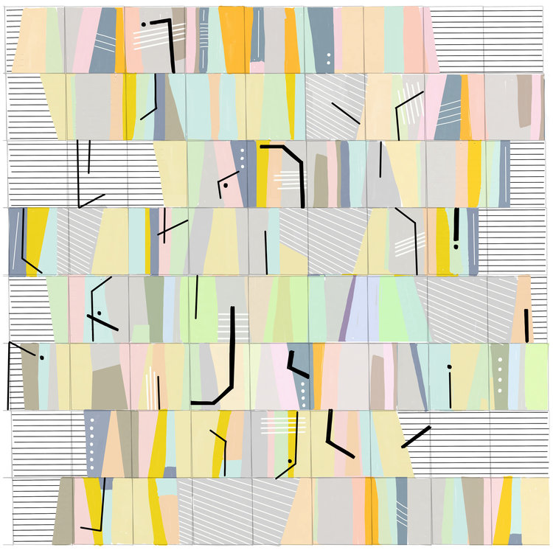
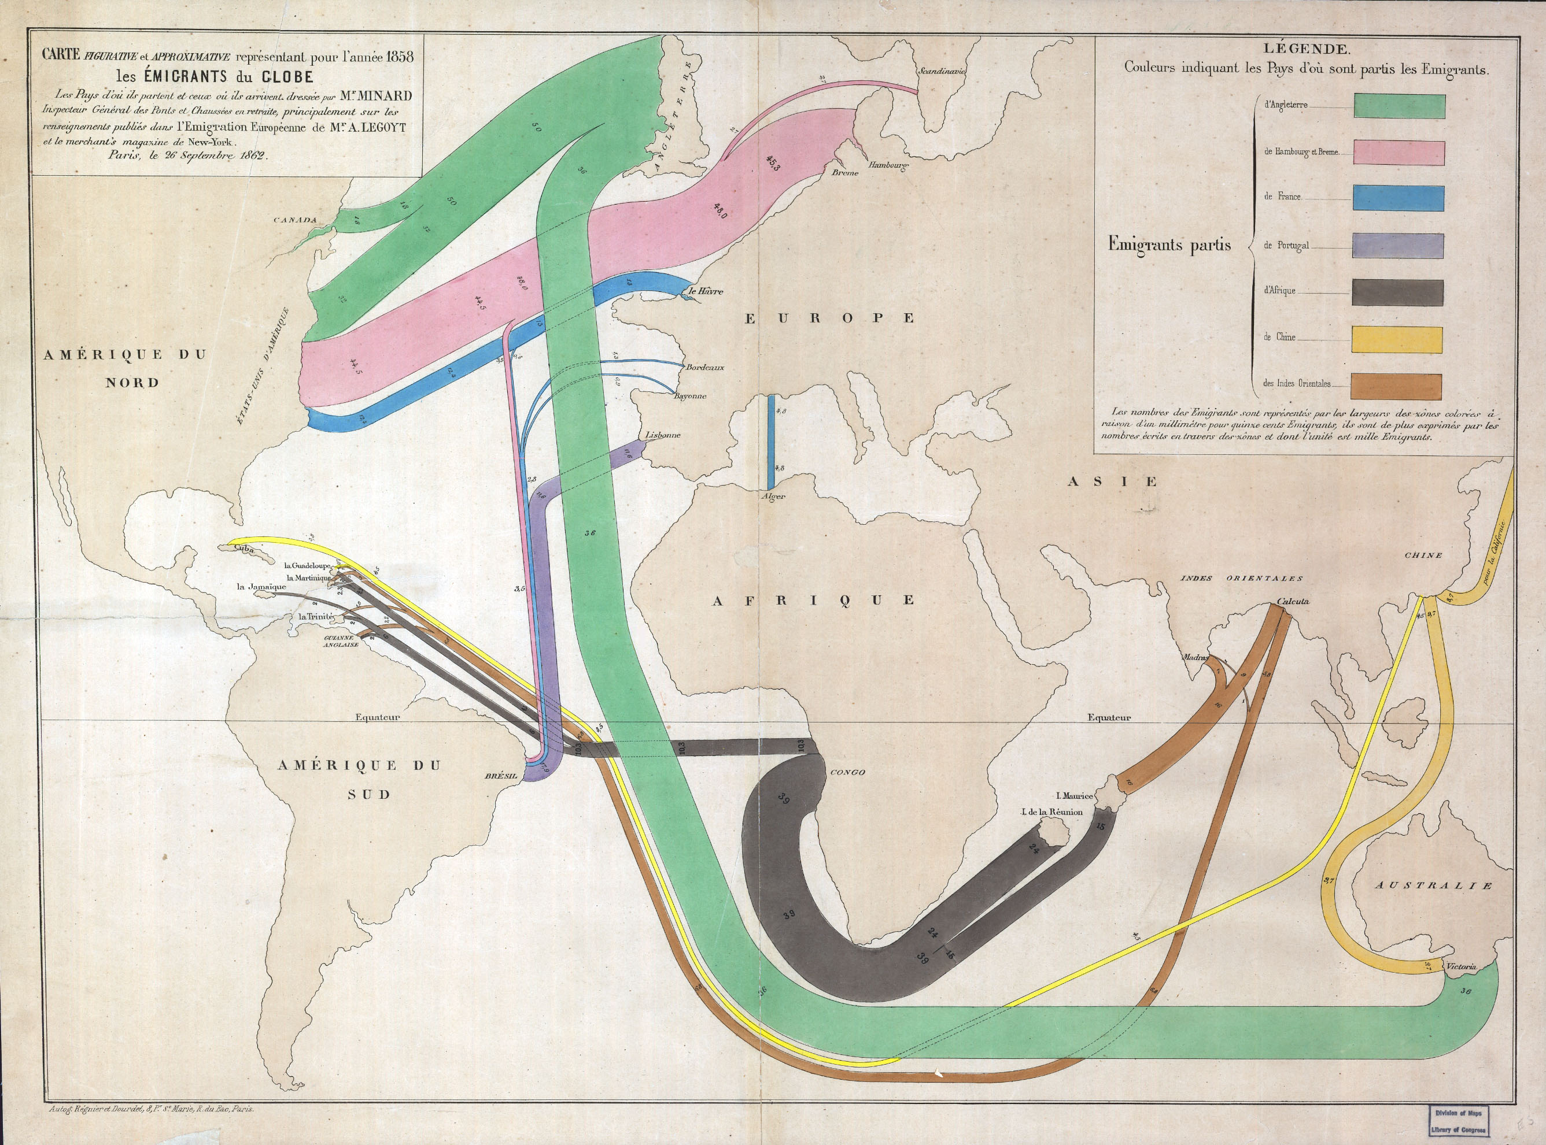
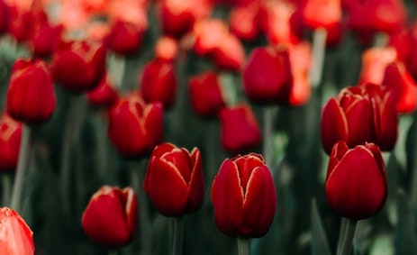
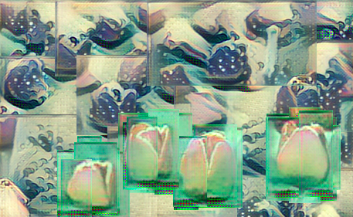
Interactive Canvas Style Transfer
Mahika Dubey
mahika@ucsc.edu
Jasmine Otto
jtotto@ucsc.edu
Angus Forbes
angus@ucsc.edu
Creative Coding Lab
UC Santa Cruz
Introduction and Motivation
We have created web applications for the novel application of multiple style-transfer brushes onto an image, allowing users to interact with deep convolutional neural networks to co-create customized art. The applications provide new perspectives on a well-known algorithmic process, and enhances intuition for its expressive range by introducing a way of layering multiple different styles onto a single image.
What is Style Transfer?
Style transfer is a method of applying style features of an image to the content of a new image to generate a similar looking result. All models used in this application were produced from running a single content image input through a 19 layer feature extractor network (VGG-19) that has been trained on over a million images from ImageNet. Fast VGG architectures for deep style transfer do not train on the content image, resulting in a style transfer network which works even on unseen images, therefore, we consider the technology mature enough to support a casual creator experience.
Magic Markers
The Magic Marker application uses a sketch-based interface that users can ’paint’ on styles through intuitive selection and dragging. Clicking on one of a set of style buttons begins the process of computing the styled image on a hidden layer underneath the main canvas. Brush selections on the canvas can then be dragged or reshaped to reveal the style in the ‘painted’ areas.
Content Image
+
VGG 19 Style Extractor
=
Result
Painter Brushes
Initial framework used only pre-trained brushes available from ml5.js, a Javascript library for web-based machine learning projects.
DataViz Art Brushes
We created custom brushes using famous data visualization art pieces by Giorgia Lupi and Charles Minard.
Compositing Stamps
The Compositing Stamps application uses real time transfer of selected sections of an image to layer on patches of style to create interesting works of art resembling tiled mosaics or collages.
Art Creation Process
We sought to understand the role of artistic vision in art creation. Thinking of style transfer inherently separates the creative process for creating an art piece by forcing the user to pick out an image to modify (layout) in its entirety, and identifying an existing style to mimic (colors). The traditional roles of artist and curator are intertwined.
References
1. Leon A. Gatys, Alexander S. Ecker, and Matthias Bethge. 2015. A Neural Algorithm of Artistic Style. CoRR abs/1508.06576 (2015).
2. Justin Johnson, Alexandre Alahi, and Fei-Fei Li. 2016. Perceptual Losses for Real-Time Style Transfer and Super-Resolution. (2016).
3. Kate Compton and Michael Mateas. [n. d.]. Casual Creators.

